Slide 1
Our ES Project.
Data structures and algorithms
Group Members.
M Rooshan Naeem
M samiullah bilal
Faizan zafar

Slide 2
What is Basically our Project??
Project Title:
“Spell Checker And Anagram Solver ☺”

Slide 3

Spell Checker
As its name implies it checks the spelling.
User enters incorrect speeling of a word.No problem,our Spell checker will take this word as an input and returns as a result the correct word.

Slide 4
Ok what is Anagram?
Anagram is basically jumbled word
And out of these jumbled word Our anagram function returns the possible words that can be make.
User can enter letters of any length and will get as a result proper words.

Slide 5
Anagram Solving Game.
So there is a game too
That is System generates some random letters and using these letters the player has to make all possible words of any length of course not more than the length of given letters
Stats of each player is maintained and stored.
If there is tie between two players then on the basis of time the players consume in solving that anagram, a Winner is selected.

Slide 6
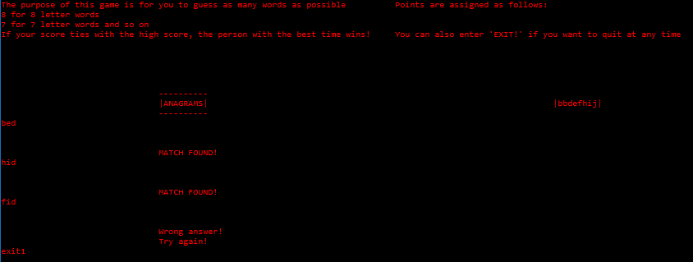

Game….

Slide 7
That’s it!
Thank You!

